Slide 1
The Limits to Growth: Sustainability and the Circular Economy
Lecture 4: Sustainability and Political (In-)Action
Prof. Dr. Benjamin Leiding
M.A. Theresa Sommer

Slide 2
License
This work is licensed under a Creative Commons Attribution-ShareAlike 4.0 International License. To view a copy of this license, please refer to https://creativecommons.org/licenses/by-sa/4.0/ .
Updated versions of these slides will be available in our Github repository.

Slide 3
E02 – A Jar of Waste

Slide 4
E02 – Household Waste
Results ADD IN RESULTS

Slide 5
E02 – Household Waste
Results
“Tips for Zero Waste Living – How a Family of 5 Makes Almost No Waste! | Life With Less Waste” by Happen Films – Link
How long did the family of 5 (all of them together) manage to squeeze all their trash into a jar?

Slide 6
E02 – Household Waste
Results
“Tips for Zero Waste Living – How a Family of 5 Makes Almost No Waste! | Life With Less Waste” by Happen Films – Link
How long did the family of 5 (all of them together) manage to squeeze all their trash into a jar?

Slide 7
Introduction

Slide 8
Introduction
Sustainability
„Development that meets the needs of the present without compromising the ability of future generations to meet their own needs.”
Report of the World Commission on Environment and Development: Our Common Future (1987) – http://www.un-documents.net/our-common-future.pdf

Slide 9
Introduction
Sustainability – Origins
„Wie eine sothane [solche] Conservation und Anbau des Holzes anzustellen / daß es eine continuirliche beständige und nachhaltende Nutzung gebe / weiln es eine unentbehrliche Sache ist / ohne welche das Land in seinem Esse nicht bleiben mag” – Hans Carl von Carlowitz (1713)
Hans Carl von Carlowitz (1713) – Sylvicultura oeconomica

Slide 10
Introduction
Sustainability – Origins
„Wie eine sothane [solche] Conservation und Anbau des Holzes anzustellen / daß es eine continuirliche beständige und nachhaltende Nutzung gebe / weiln es eine unentbehrliche Sache ist / ohne welche das Land in seinem Esse nicht bleiben mag” – Hans Carl von Carlowitz (1713)
→ “continuously enduring and sustainable use”
Hans Carl von Carlowitz (1713) – Sylvicultura oeconomica

Slide 11
Introduction
Sustainability – Origins
„Sowing and planting of trees had to be regarded as a national duty of every landowner, in order to stop the destructive over-exploitation of natural resources” – John Evelyn (1662)
John Evelyn (1662) – Essay: „Sylva2

Slide 12
Introduction
Sustainability – Origins
Carl von Carlowitz and Sustainability
Coined the term at a time when Europe was in need of vast quantities of wood (mining, ore-smelting, ship building, etc.
→ Fear of timber scarcity
Growing population → Fear of food-shortage if food production cannot keep up with reproduction
World population in 1700 → ca. 0.6 billion people
World population in 1800 → ca. 1.0 billion people
Industrial revolution (ca. 1760 – 1840) fostered environmental degradation → society chose prosperity rather than sustainability

Slide 13
Biocapacity
Definition
Is „the locally available carrying capacity of the ecosystem for generating resources and absorbing wastes”
D. Yue, J. Guo, C. Hui (2013) – Scale dependency of biocapacity and the fallacy of unsustainable development – https://doi.org/10.1016/j.jenvman.2013.04.022

Slide 14
Ecological Footprint
Definition
„The ecological footprint for a particular population is defined as the total area of
productive land and water ecosystems required to produce sufficient resources and assimilate wastes”
1.) W.E. Rees (1992) – Ecological footprint and appropriated carrying capacity: what urban economics leaves out. Environmental Urbanization.
2.) W.E. Rees, M. Wackernagel (1994) – Ecological footprints and appropriated carrying capacity: measuring the natural capital requirements of the human economy.
3.) D. Yue, J. Guo, C. Hui (2013) – Scale dependency of biocapacity and the fallacy of unsustainable development – https://doi.org/10.1016/j.jenvman.2013.04.022

Slide 15
Sustainability
Definition
Social
Economic
Environment
Based on: Thomsen C. (2013) Sustainability (World Commission on Environment and Development Definition). In: Idowu S.O., Capaldi N., Zu L., Gupta A.D. (eds) Encyclopedia of Corporate Social Responsibility. Springer, Berlin, Heidelberg. https://doi.org/10.1007/978-3-642-28036-8_531

Slide 16
Sustainability
Definition
Social
Bearable
Equitable
Viable
Economic
Environment
Based on: Thomsen C. (2013) Sustainability (World Commission on Environment and Development Definition). In: Idowu S.O., Capaldi N., Zu L., Gupta A.D. (eds) Encyclopedia of Corporate Social Responsibility. Springer, Berlin, Heidelberg. https://doi.org/10.1007/978-3-642-28036-8_531

Slide 17
Sustainable
Sustainability
Definition
Social
Bearable
Equitable
Viable
Economic
Environment
Based on: Thomsen C. (2013) Sustainability (World Commission on Environment and Development Definition). In: Idowu S.O., Capaldi N., Zu L., Gupta A.D. (eds) Encyclopedia of Corporate Social Responsibility. Springer, Berlin, Heidelberg. https://doi.org/10.1007/978-3-642-28036-8_531

Slide 18
Sustainability
Implications
Sustainability → Consume less

Slide 19
Sustainability
Linear Economy – Definition
“Take – Make – Dispose”

Slide 20
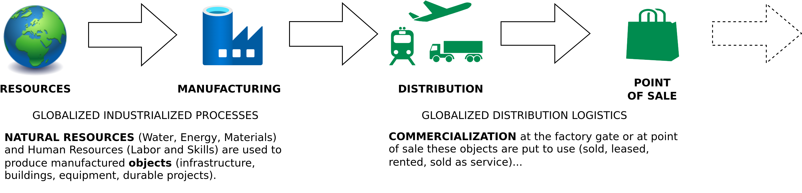
Sustainability
The Linear (Industrial) Economy
Image adapted from: Walter R. Stahel (2019) – The Circular Economy: A User’s Guide.

Slide 21
Sustainable Development Goals

Slide 22
Sustainable Development Goals
Overview
Sustainable Development Goals → SDGs
17 interlinked goals
Proposed in 2015 by the United Nations General Assembly
To be achieved by 2030 by all UN member states
Each goal typically has 8–12 targets, and each target has between 1-4 indicators used to measure progress toward reaching the targets.
“A blueprint to achieve a better and more sustainable future for all people and the world by 2030” – United Nations General Assembly

Slide 23
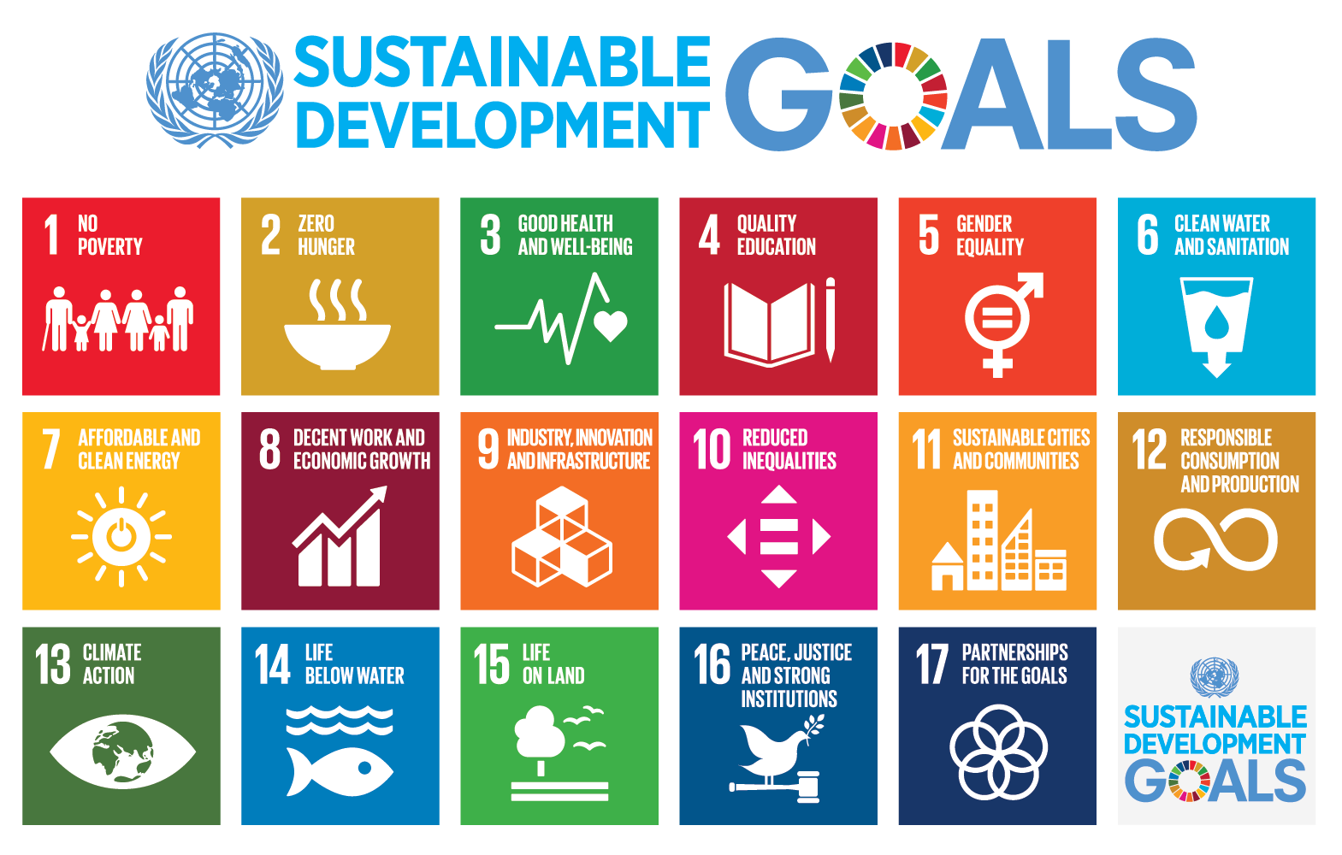
Sustainable Development Goals
Sustainable Development Goals – Unknown author, Public domain, via Wikimedia Commons – https://commons.wikimedia.org/wiki/File:Sustainable_Development_Goals.png

Slide 24
Sustainable Development Goals
Issues
No prioritization
“The means of implementation targets under each Sustainable Development Goal and Goal 17, which are referred to above, are key to realizing our Agenda and are of equal importance with the other Goals and targets. We shall accord them equal priority in our implementation efforts and in the global indicator framework for monitoring our progress.”
United Nations General Assembly (2015) – Resolution adopted by the General Assembly on 25 September 2015 – https://upload.wikimedia.org/wikipedia/commons/d/d5/N1529189.pdf

Slide 25
Sustainable Development Goals
Issues
Water, food and energy are vital prerequisites for any human life → other goals cannot be achieved without them
Each goal by itself does not guarantee sustainability
Achieving all goals is quite challenging → Stakeholders focus on particular goals which risks to achieve all goals (no sustainability if we just achieve 8 out of 17 goals)
Potential/risk for/of greenwashing

Slide 26
Sustainable Development Goals
Issues
Water, food and energy are vital prerequisites for any human life → other goals cannot be achieved without them
Each goal by itself does not guarantee sustainability
Achieving all goals is quite challenging → Stakeholders focus on particular goals which risks to achieve all goals (no sustainability if we just achieve 8 out of 17 goals)
Potential/risk for/of greenwashing

Slide 27
Sustainable Development Goals
Issues
Water, food and energy are vital prerequisites for any human life → other goals cannot be achieved without them
Each goal by itself does not guarantee sustainability
Achieving all goals is quite challenging → Stakeholders focus on particular goals which risks to achieve all goals (no sustainability if we just achieve 8 out of 17 goals)
Potential/risk for/of greenwashing

Slide 28
Sustainable Development Goals
Issues
Water, food and energy are vital prerequisites for any human life → other goals cannot be achieved without them
Each goal by itself does not guarantee sustainability
Achieving all goals is quite challenging → Stakeholders focus on particular goals which risks to achieve all goals (no sustainability if we just achieve 8 out of 17 goals)
Potential/risk for/of greenwashing

Slide 29
A Short History of Actions on Climate Change

Slide 30
A Short History of Actions on Climate Change
(Incomplete) Timeline
1957 – First climate change warnings issued by Roger Revelle and Hans Suess
1958 – Start of systematic measurements of atmospheric CO2 by Dave Keeling
1972 – United Nations Conference on the Human Environment (Stockholm)
1979 – First World Climate Conference (Geneva)
1988 – IPCC (Intergovernmental Panel on Climate Change) founded
1992 – Earth Summit (Rio)
1997 – Kyoto Protocol
2009 – Copenhagen Accord
2015 – Paris Agreement
2021 – Glasgow Climate Pact

Slide 31
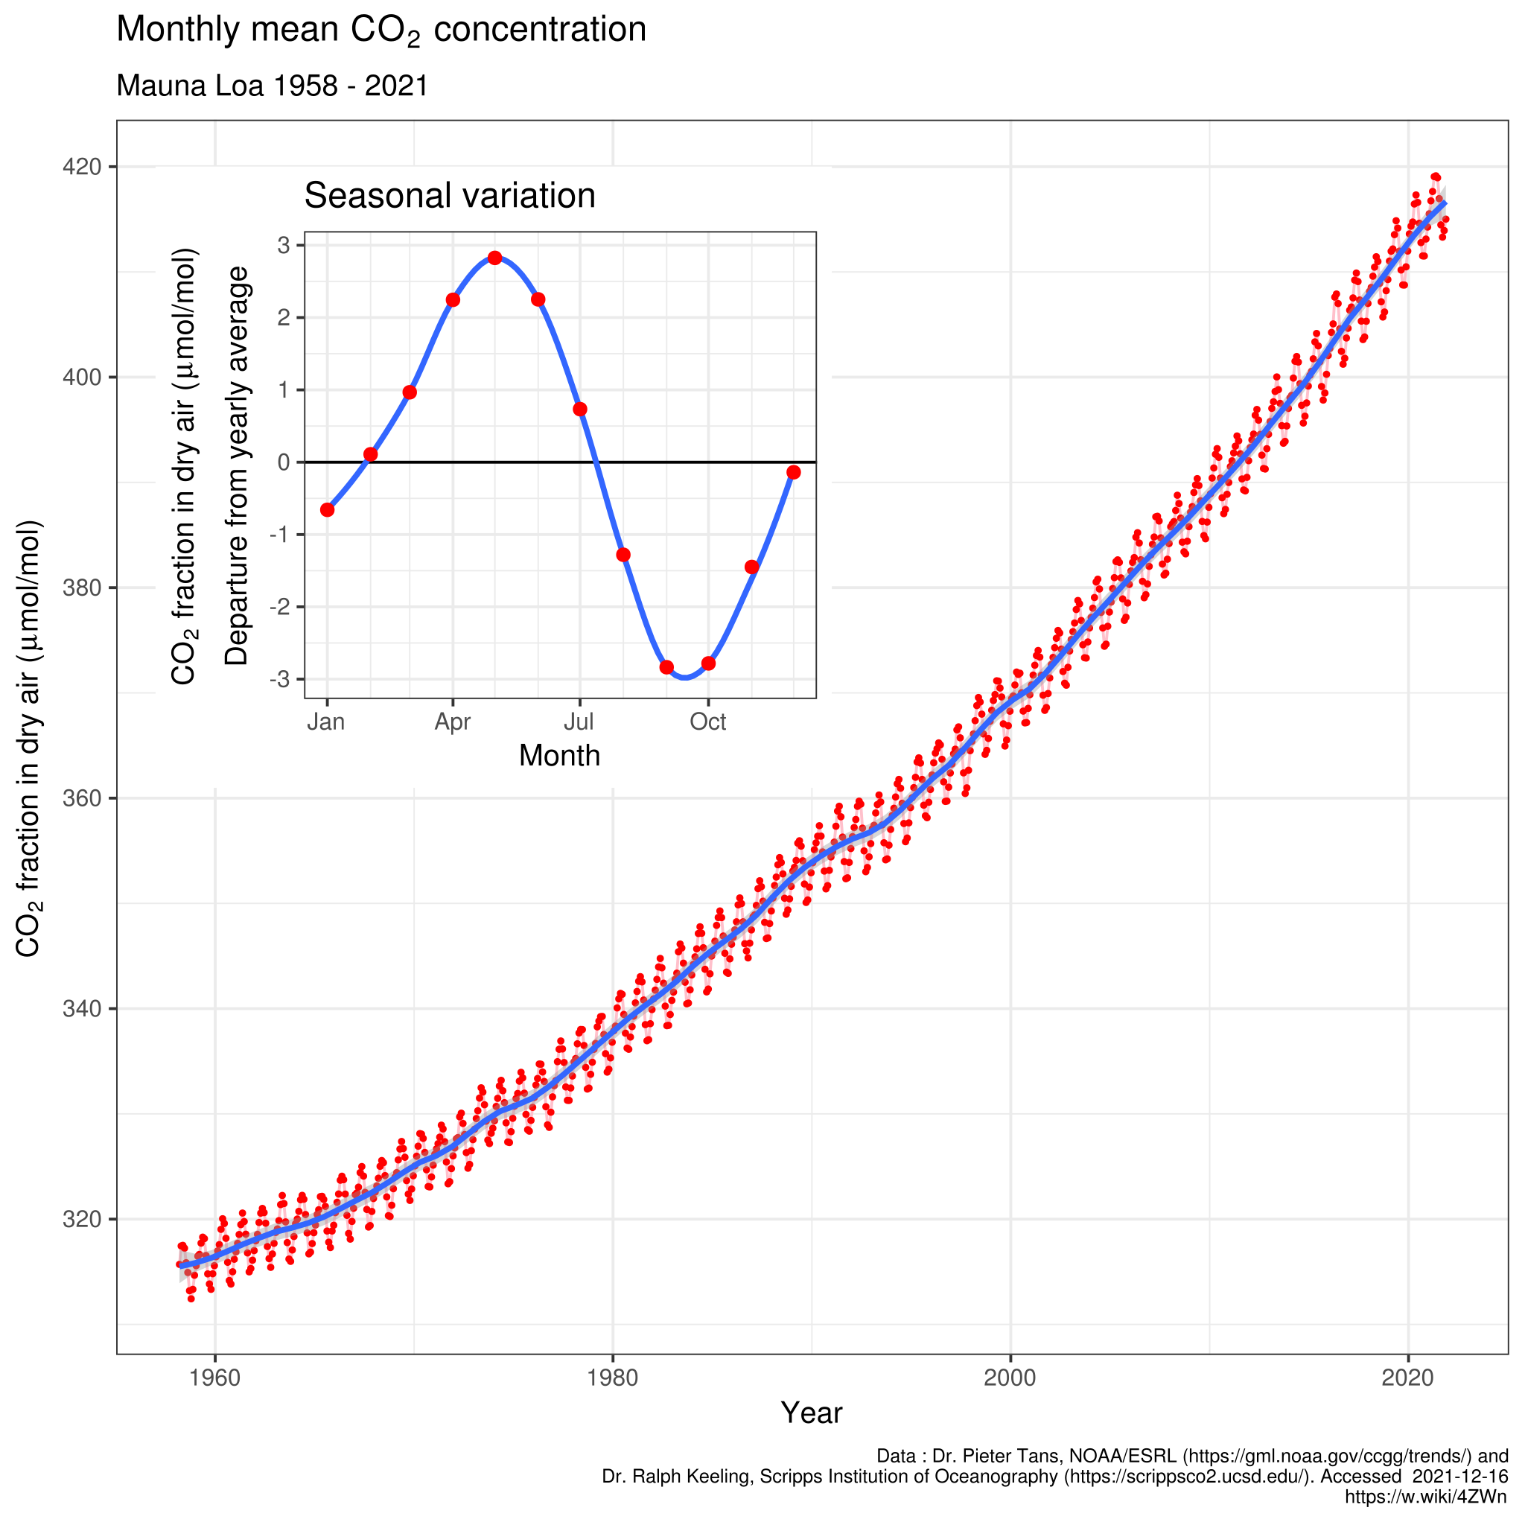
A Short History of Actions on Climate Change
Detour – Keeling Curve
Named after Charles David Keeling
Graph representation of the accumulation of CO2 in the atmosphere based on continuous measurements (Mauna Loa Observatory – Hawaii) from 1958 to the present day
Delorme – https://commons.wikimedia.org/wiki/File:Mauna_Loa_CO2_monthly_mean_concentration.svg – CC BY-SA 4.0.

Slide 32
A Short History of Actions on Climate Change
1979 – First World Climate Conference (Geneva)
First major meeting on climate change
Initiated by the World Meteorological Organization (WMO)
Scientific gathering explored how climate change might affect human activities
Led to the creation of the Intergovernmental Panel on Climate Change (IPCC)
Urged governments “to foresee and prevent potential man-made changes in climate that might be adverse to the well-being of humanity”
https://unfccc.int/cop3/fccc/climate/fact17.htm

Slide 33
A Short History of Actions on Climate Change
1988 – IPCC (Intergovernmental Panel on Climate Change)
Intergovernmental body of the United Nations
Task: “Provide policymakers with regular assessments of the scientific basis of climate change, its impacts and future risks, and options for adaptation and mitigation”
IPCC assessments:
provide a scientific basis for governments to develop climate related policies
are policy-relevant but not policy prescriptive: they may present projections of future climate change based on different scenarios and the risks that climate change poses and discuss the implications of response options, but they do not tell policymakers what actions to take.
A
re written by hundreds of leading scientists who volunteer their time and expertise as Coordinating Lead Authors and Lead Authors of the reports. They enlist hundreds of other experts as Contributing Authors to provide complementary expertise in specific areas
IPCC (2022) – https://www.ipcc.ch/about/

Slide 34
A Short History of Actions on Climate Change
1988 – IPCC (Intergovernmental Panel on Climate Change)
Intergovernmental body of the United Nations
Task: “Provide policymakers with regular assessments of the scientific basis of climate change, its impacts and future risks, and options for adaptation and mitigation”
IPCC assessments:
provide a scientific basis for governments to develop climate related policies
are policy-relevant but not policy prescriptive: they may present projections of future climate change based on different scenarios and the risks that climate change poses and discuss the implications of response options, but they do not tell policymakers what actions to take.
are written by hundreds of leading scientists who volunteer their time and expertise as Coordinating Lead Authors and Lead Authors of the reports. They enlist hundreds of other experts as Contributing Authors to provide complementary expertise in specific areas
IPCC (2022) – https://www.ipcc.ch/about/

Slide 35
A Short History of Actions on Climate Change
1997 – Kyoto Protocol
Commitment to reduce GHG emissions and concentration in the atmosphere to “a level that would prevent dangerous anthropogenic interference with the climate system”
Recognizing that global warming occurs and that human-made GHG emissions are driving it
Developed nations pledge to reduce “overall emissions of such gases by at least 5 per cent below 1990 levels in the commitment period 2008 to 2012”.
Entered into force on 16 February 2005
However
→ USA, Australia and other countries refused to ratify the agreement
→ Canada withdrew from the Kyoto Protocol in 2012
United Nations (1997) – Kyoto Protocol – https://en.wikisource.org/wiki/Kyoto_Protocol

Slide 36
A Short History of Actions on Climate Change
1997 – Kyoto Protocol
Commitment to reduce GHG emissions and concentration in the atmosphere to “a level that would prevent dangerous anthropogenic interference with the climate system”
Recognizing that global warming occurs and that human-made GHG emissions are driving it
Developed nations pledge to reduce “overall emissions of such gases by at least 5 per cent below 1990 levels in the commitment period 2008 to 2012”.
Entered into force on 16 February 2005
However
→ USA, Australia and other countries refused to ratify the agreement
→ Canada withdrew from the Kyoto Protocol in 2012
United Nations (1997) – Kyoto Protocol – https://en.wikisource.org/wiki/Kyoto_Protocol

Slide 37
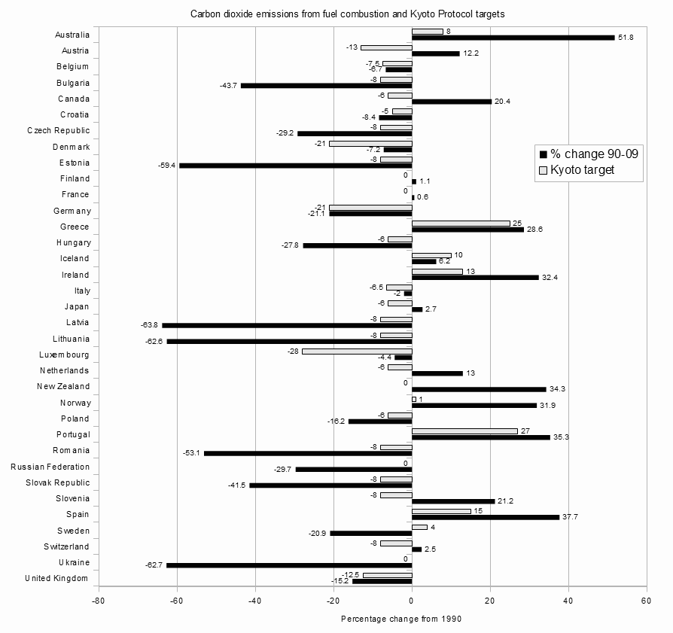
A Short History of Actions on Climate Change
1997 – Kyoto Protocol
Enescot – https://commons.wikimedia.org/wiki/File:Kyoto_Parties_with_first_period_(2008-2012)_greenhouse_gas_emissions_limitations_targets_and_the_percentage_change_in_their_carbon_dioxide _emissions_from_fuel_combustion_between_1990_and_2009.png – CC BY-SA 3.0.

Slide 38
A Short History of Actions on Climate Change
2009 – Copenhagen Accord
Drafted by only 5 countries
Not legally binding
No real targets
Content:
Endorses the continuation of the Kyoto Protocol
“We emphasise our strong political will to urgently combat climate change in accordance with the principle of common but differentiated responsibilities and respective capabilities”
“We shall, recognizing the scientific view that the increase in global temperature should be below 2 degrees Celsius”
United Nations (2009) – Copenhagen Accord – https://unfccc.int/resource/docs/2009/cop15/eng/l07.pdf

Slide 39
A Short History of Actions on Climate Change
2009 – Copenhagen Accord
Drafted by only 5 countries
Not legally binding
No real targets
Content:
Endorses the continuation of the Kyoto Protocol
“We emphasise our strong political will to urgently combat climate change in accordance with the principle of common but differentiated responsibilities and respective capabilities”
“We shall, recognizing the scientific view that the increase in global temperature should be below 2 degrees Celsius”
United Nations (2009) – Copenhagen Accord – https://unfccc.int/resource/docs/2009/cop15/eng/l07.pdf

Slide 40
A Short History of Actions on Climate Change
2009 – Copenhagen Accord
Drafted by only 5 countries
Not legally binding
No real targets
Content:
Endorses the continuation of the Kyoto Protocol
“We emphasise our strong political will to urgently combat climate change in accordance with the principle of common but differentiated responsibilities and respective capabilities”
“We shall, recognizing the scientific view that the increase in global temperature should be below 2 degrees Celsius”
United Nations (2009) – Copenhagen Accord – https://unfccc.int/resource/docs/2009/cop15/eng/l07.pdf

Slide 41
A Short History of Actions on Climate Change
2009 – Copenhagen Accord
Drafted by only 5 countries
Not legally binding
No real targets
Content:
Endorses the continuation of the Kyoto Protocol
“We emphasise our strong political will to urgently combat climate change in accordance with the principle of common but differentiated responsibilities and respective capabilities”
“We shall, recognizing the scientific view that the increase in global temperature should be below 2 degrees Celsius”
United Nations (2009) – Copenhagen Accord – https://unfccc.int/resource/docs/2009/cop15/eng/l07.pdf

Slide 42
A Short History of Actions on Climate Change
2015 – Paris Agreement
Reach global peaking of greenhouse gas emissions as soon as possible
Holding the increase in the global average temperature to well below 2°C above pre-industrial levels
Pursuing efforts to limit the temperature increase to 1.5°C above pre-industrial levels, recognizing that this would significantly reduce the risks and impacts of climate change;
Increasing the ability to adapt to the adverse impacts of climate change and foster climate resilience and low greenhouse gas emissions development, in a manner that does not threaten food production; and
Making finance flows consistent with a pathway towards low greenhouse gas emissions and climate-resilient development.
United Nations (2015) – Paris Agreement – https://unfccc.int/sites/default/files/english_paris_agreement.pdf

Slide 43
A Short History of Actions on Climate Change
2015 – Paris Agreement
Reach global peaking of greenhouse gas emissions as soon as possible
Holding the increase in the global average temperature to well below 2°C above pre-industrial levels
Pursuing efforts to limit the temperature increase to 1.5°C above pre-industrial levels, recognizing that this would significantly reduce the risks and impacts of climate change;
Increasing the ability to adapt to the adverse impacts of climate change and foster climate resilience and low greenhouse gas emissions development, in a manner that does not threaten food production; and
Making finance flows consistent with a pathway towards low greenhouse gas emissions and climate-resilient development.
United Nations (2015) – Paris Agreement – https://unfccc.int/sites/default/files/english_paris_agreement.pdf

Slide 44
A Short History of Actions on Climate Change
2015 – Paris Agreement
Reach global peaking of greenhouse gas emissions as soon as possible
Holding the increase in the global average temperature to well below 2°C above pre-industrial levels
Pursuing efforts to limit the temperature increase to 1.5°C above pre-industrial levels, recognizing that this would significantly reduce the risks and impacts of climate change;
Increasing the ability to adapt to the adverse impacts of climate change and foster climate resilience and low greenhouse gas emissions development, in a manner that does not threaten food production; and
Making finance flows consistent with a pathway towards low greenhouse gas emissions and climate-resilient development.
United Nations (2015) – Paris Agreement – https://unfccc.int/sites/default/files/english_paris_agreement.pdf

Slide 45
A Short History of Actions on Climate Change
2015 – Paris Agreement
Reach global peaking of greenhouse gas emissions as soon as possible
Holding the increase in the global average temperature to well below 2°C above pre-industrial levels
Pursuing efforts to limit the temperature increase to 1.5°C above pre-industrial levels, recognizing that this would significantly reduce the risks and impacts of climate change;
Increasing the ability to adapt to the adverse impacts of climate change and foster climate resilience and low greenhouse gas emissions development, in a manner that does not threaten food production; and
Making finance flows consistent with a pathway towards low greenhouse gas emissions and climate-resilient development.
United Nations (2015) – Paris Agreement – https://unfccc.int/sites/default/files/english_paris_agreement.pdf

Slide 46
A Short History of Actions on Climate Change
2015 – Paris Agreement
Reach global peaking of greenhouse gas emissions as soon as possible
Holding the increase in the global average temperature to well below 2°C above pre-industrial levels
Pursuing efforts to limit the temperature increase to 1.5°C above pre-industrial levels, recognizing that this would significantly reduce the risks and impacts of climate change;
Increasing the ability to adapt to the adverse impacts of climate change and foster climate resilience and low greenhouse gas emissions development, in a manner that does not threaten food production; and
Making finance flows consistent with a pathway towards low greenhouse gas emissions and climate-resilient development.
United Nations (2015) – Paris Agreement – https://unfccc.int/sites/default/files/english_paris_agreement.pdf

Slide 47
A Short History of Actions on Climate Change
2021 – Glasgow Climate Pact
Reaffirms the Paris Agreement temperature goal of holding the increase in the global average temperature to well below 2 °C above pre-industrial levels and pursuing efforts to limit the temperature increase to 1.5 °C above pre-industrial levels
Including accelerating efforts towards the phase-out of unabated coal power and inefficient fossil fuel subsidies
Urges developed country Parties to provide enhanced support, including through financial resources, technology transfer and capacity-building, to assist developing country
United Nations (2021) – Glasgow Climate Pact – https://unfccc.int/sites/default/files/resource/cma2021_L16_adv.pdf

Slide 48
A Short History of Actions on Climate Change
2021 – Glasgow Climate Pact
Reaffirms the Paris Agreement temperature goal of holding the increase in the global average temperature to well below 2 °C above pre-industrial levels and pursuing efforts to limit the temperature increase to 1.5 °C above pre-industrial levels
Including accelerating efforts towards the phase-out of unabated coal power and inefficient fossil fuel subsidies
Urges developed country Parties to provide enhanced support, including through financial resources, technology transfer and capacity-building, to assist developing country
United Nations (2021) – Glasgow Climate Pact – https://unfccc.int/sites/default/files/resource/cma2021_L16_adv.pdf

Slide 49
A Short History of Actions on Climate Change
2021 – Glasgow Climate Pact
Reaffirms the Paris Agreement temperature goal of holding the increase in the global average temperature to well below 2 °C above pre-industrial levels and pursuing efforts to limit the temperature increase to 1.5 °C above pre-industrial levels
Including accelerating efforts towards the phase-out of unabated coal power and inefficient fossil fuel subsidies
Urges developed country Parties to provide enhanced support, including through financial resources, technology transfer and capacity-building, to assist developing country
United Nations (2021) – Glasgow Climate Pact – https://unfccc.int/sites/default/files/resource/cma2021_L16_adv.pdf

Slide 50
A Short History of Actions on Climate Change
2021 – Glasgow Climate Pact
140 countries pledged to reach net-zero emissions
100+ countries pledged to reverse deforestation by 2030
40+ countries pledged to move away from coal
United Nations (2021) – Glasgow Climate Pact – https://unfccc.int/sites/default/files/resource/cma2021_L16_adv.pdf

Slide 51
Activism

Slide 52
Activism
Bla, bla bla – Link

Slide 53
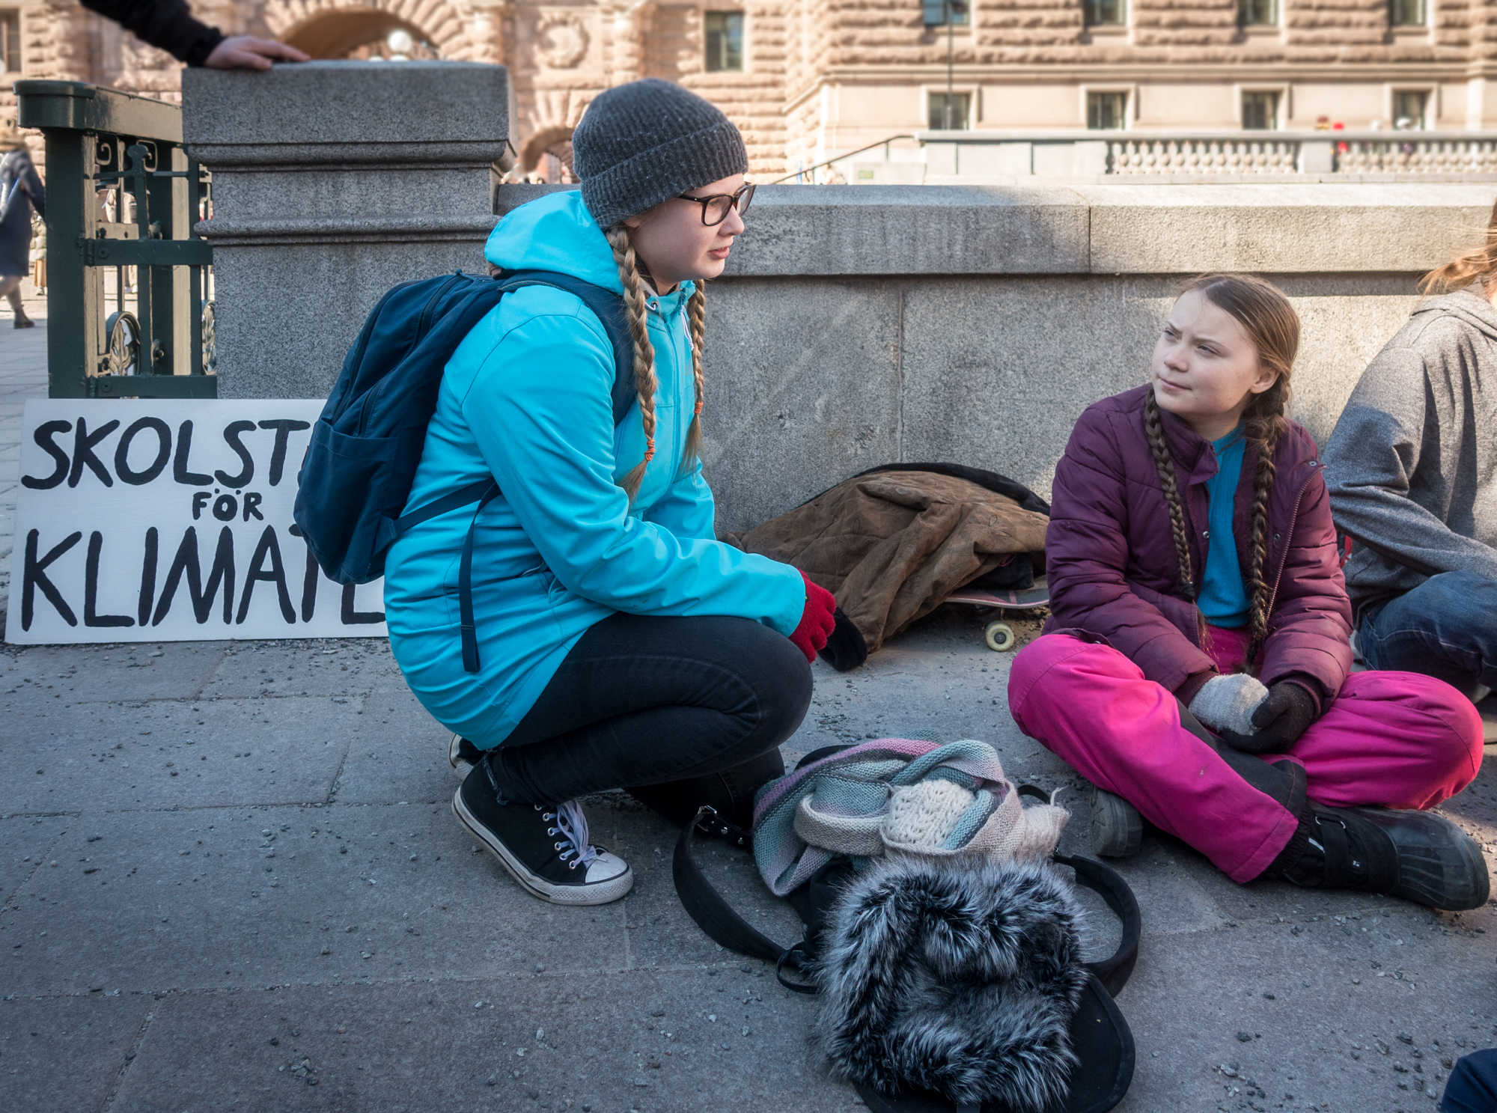
Activism
Fridays for Future
Frankie Fouganthin (2019) – https://commons.wikimedia.org/wiki/File:Greta_Thunberg_in_School_strike_for_the_climate.jpg – CC BY-SA 4.0.

Slide 54
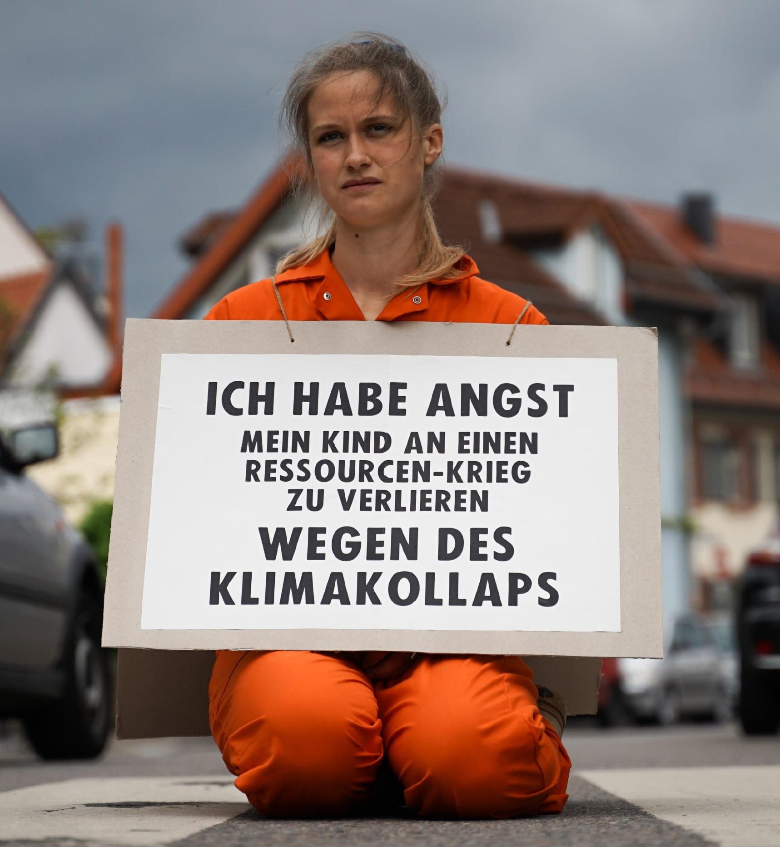
Activism
Extinction Rebellion (XR)
“I am afraid of losing my child to a resource war because of a climate collapse”
XR Strategiepapier 2022 – Pusteblumen und Hype. Bilder: Sebastian Höhn, Joe Pohl, Sandra Doneck, Alessandro Brönnimann

Slide 55
Activism
Extinction Rebellion (XR)
Vladimir Morozov (2019) – https://xrbristol.org.uk/2020/04/17/blog-xr-has-sticking-power/ – CC BY-SA 4.0.

Slide 56
Activism
“Climate activists are sometimes depicted as dangerous radicals, but the truly dangerous radicals are the countries that are increasing the production of fossil fuels.”
United Nations Secretary General Antonio Guterres

Slide 57
Activism
“Climate activists are sometimes depicted as dangerous radicals, but the truly dangerous radicals are the countries that are increasing the production of fossil fuels.”
United Nations Secretary General Antonio Guterres

Slide 58
Activism
Extinction Rebellion (XR)
Beyond just protesting (Lars Werner): Link

Slide 59
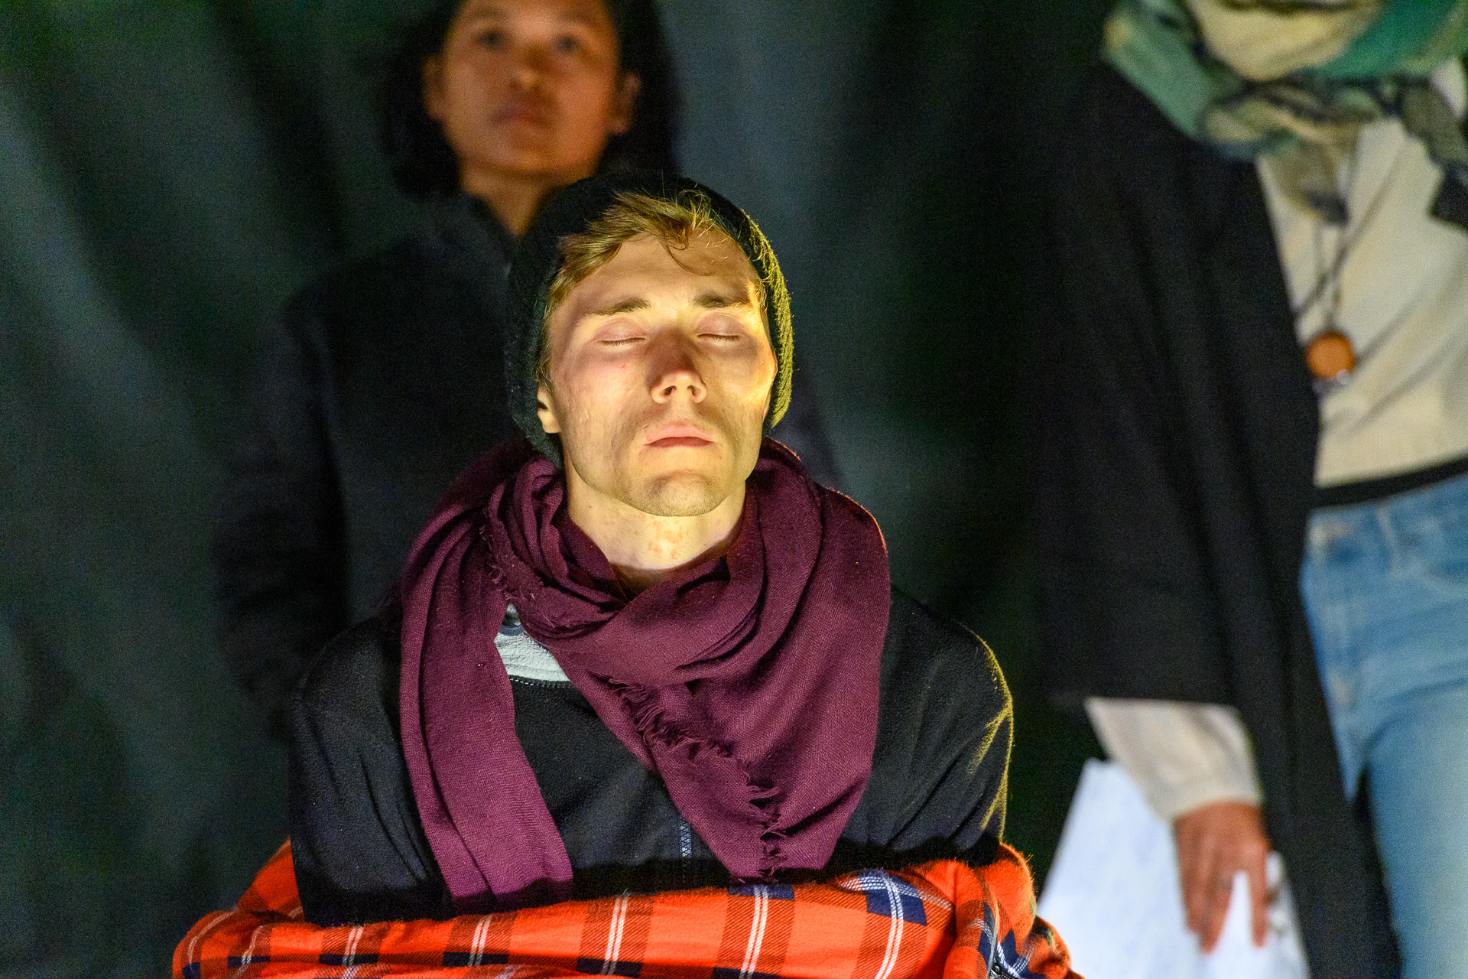
Activism
Last Generation (Letzte Generation)
2021 → before the elections in Germany
27 days hunger strike (picture day 25) → afterwards Intensive Care Unit
Together with other climate activists, Jeschke wanted to use this drastic means to draw attention to the climate crisis and achieve a discussion with the candidates for chancellor.
Olaf Scholz (Chancellor Germany) and Last Generation → Video
Stefan Müller (2021) – https://www.flickr.com/photos/184802432@N05/51541641486 – CC BY 2.0.

Slide 60
Activism
Neubauer, et al. vs. Germany
https://www.germanwatch.org/en/node/20134

Slide 61
Activism
Neubauer, et al. vs. Germany
Nine young people from Germany sued Germany
They argue: “that the goals and measures of the Federal Climate Protection Act are not sufficient to effectively protect their fundamental rights from the consequences of the climate crisis as well as to fulfill the government’s obligations under the Paris Agreement.”
They won! → “Freedoms and fundamental rights are already being violated today by insufficient climate protection. The legislator must adapt the Federal Climate Protection Act by the end of 2022”
“Climate protection is not nice-to-have, fair climate protection is a fundamental right, that is now official. A huge success - for everyone and especially for us young people who have been on climate strike for their future for over two years. We will now continue to fight for a 1.5 degree policy that is fair to all generations.” – Luisa Neubauer
https://www.germanwatch.org/en/node/20134

Slide 62
Activism
Neubauer, et al. vs. Germany
Nine young people from Germany sued Germany
They argue: “that the goals and measures of the Federal Climate Protection Act are not sufficient to effectively protect their fundamental rights from the consequences of the climate crisis as well as to fulfill the government’s obligations under the Paris Agreement.”
They won! → “Freedoms and fundamental rights are already being violated today by insufficient climate protection. The legislator must adapt the Federal Climate Protection Act by the end of 2022”
“Climate protection is not nice-to-have, fair climate protection is a fundamental right, that is now official. A huge success - for everyone and especially for us young people who have been on climate strike for their future for over two years. We will now continue to fight for a 1.5 degree policy that is fair to all generations.” – Luisa Neubauer
https://www.germanwatch.org/en/node/20134

Slide 63
Conclusion

Slide 64
Conclusion
Short history of actions on climate change
Geneva, Kyoto, Copenhagen, Paris, Glasgow, etc.
Problem
→ A lot of bla bla
→ Lack of progress
→ Policies favor business as usual instead of acting in accordance with science because they are afraid to make unpopular decisions
Individual activism as a response / counter movement to inactive governments who ignore urgent issues (i.e., the three key challenges of the 21st century)
Sustainable Development Goals → SDGs

Slide 65
Exercise E03

Slide 66
Exercise E03
My Favorite Fruit/Vegetable
Pick your favorite fruit or vegetable that you regularly buy at the grocery store.
Compile a comprehensive list of all required resources that go into the production of the chosen fruit/vegetable.
Submit your result according to the submission guidelines posted in the exercise sheet → E03.
Note: Do not only consider primary inputs → primary inputs also have various inputs themselves (e.g., secondary, tertiary)

Slide 67
Additional Resources
Podcast Episode: How to Save a Planet (2021) – We Go Inside the COP26 Climate Talks – Link
Greta Thunberg mocks world leaders in 'blah, blah, blah' speech | BBC News (2021) – Link
Rutger Bregman tells Davos to talk about tax: 'This is not rocket science' | Guardian News (2019) – Link
IPCC (2022) – About the IPCC – Link
Richard Black, BBC (2013) – A brief history of climate change – Link

Slide 68
Questions?

